Slide 1







Wining Space Race with Data Science
Sina Khodadadi
26 August 2023

Slide 2



OUTLINE
Executive Summary
Introduction
Methodology
Results
Visualization – Charts
Dashboard
Discussion
Findings & Implications
Conclusion
Appendix

Slide 3

EXECUTIVE SUMMARY
Introduction
Summary of methodologies
Data Collection & Data Wrangling
EDA & Interactive Visual Analytics Methodology
Predictive Analysis Methodology
EDA with Visualization Results
EDA With SQL Results
Interactive Map with Folium Results
Plotly Dashboard Results
Predictive Analysis (Classification) Results
Summary of all results

Slide 4

INTRODUCTION
Project background and context
SpaceX advertises Falcon 9 rocket launches on its website with a cost of 62 million dollars; other providers cost upwards of 165 million dollars each, much of the savings is because SpaceX can reuse the first stage.
Problems you want to find answers
If we can determine if the first stage will land, we can determine the cost of a launch

Slide 5

Section 1
Methodology

Slide 6

METHODOLOGY
Executive Summary
Data collection methodology:
SpaceX Rest API
Web Scrapping from SpaceX Wikipedia webpage
Perform data wrangling
Hot Encoding data fields
Data Cleaning: Correcting and Cleaning null values & irrelevant columns
Perform exploratory data analysis (EDA) using visualization and SQL
Perform interactive visual analytics using Folium and Plotly Dash
Perform predictive analysis using classification models
Different algorithm such as: Logistic Regression, K-Nearest Neighbors, Support Vector Machine, Decision Tree model have been deployed and evaluated to find the best method.

Slide 7

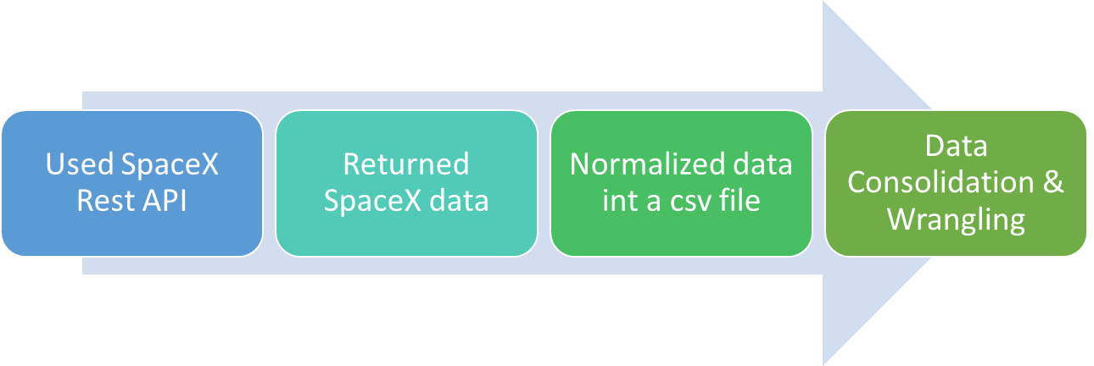

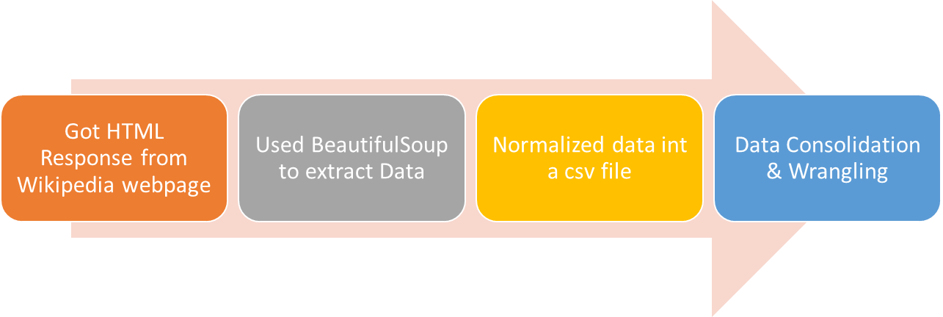

Data Collection

Slide 8
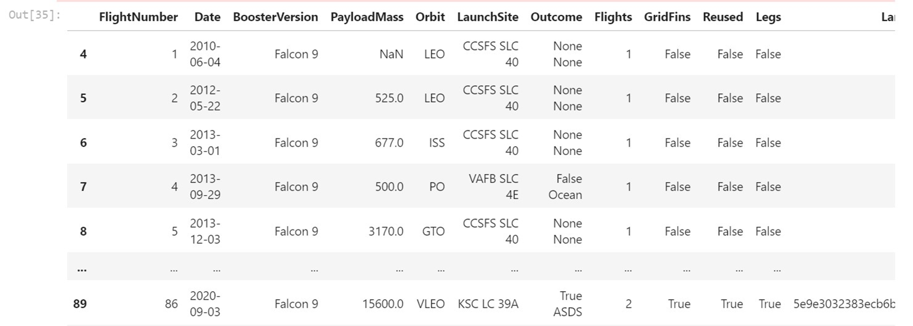
PROGRAMMING LANGUAGE TRENDS
Data collection with SpaceX REST calls
https://github.com/sinasorme/IBM-Data-Science-Capstone/blob/Module1/jupyter-labs-spacex-data-collection-api%20(2).ipynb

Slide 9

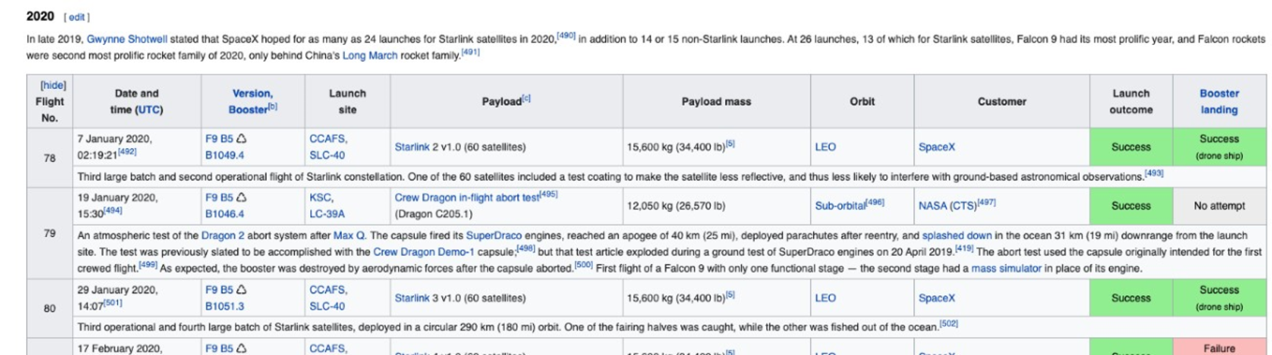

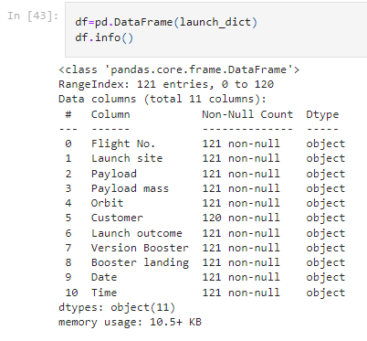
Data collection - Scraping
https://github.com/sinasorme/IBM-Data-Science-Capstone/blob/Module1/jupyter-labs-webscraping%20(2).ipynb

Slide 10
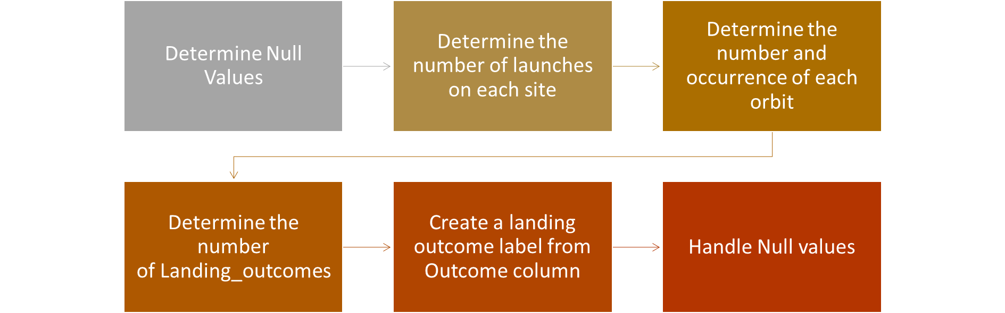
DATA Wrangling
https://github.com/sinasorme/IBM-Data-Science-Capstone/blob/Module1/IBM-DS0321EN-SkillsNetwork_labs_module_1_L3_labs-jupyter-spacex-data_wrangling_jupyterlite.jupyterlite.ipynb

Slide 11
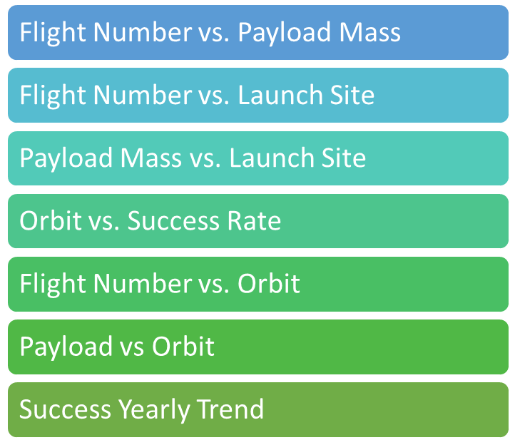
EDA with Data Visualization
For machine learning models we should get insight into the relationship between parameters. Therefore, various type of plots such as: Scatter plots, line charts, and bar plots are used to show the relation between different parameters.
https://github.com/sinasorme/IBM-Data-Science-Capstone/blob/Module2/IBM-DS0321EN-SkillsNetwork_labs_module_2_jupyter-labs-eda-dataviz.ipynb.jupyterlite.ipynb

Slide 12
EDA with SQL
Displayed the names of the unique launch sites in the space mission
Displayed 5 records where launch sites begin with the string 'CCA'
Displayed the total payload mass carried by boosters launched by NASA (CRS)
Displayed average payload mass carried by booster version F9 v1.1
Listed the date when the first successful landing outcome in ground pad was achieved.
Listed the names of the boosters which have success in drone ship and have payload mass
greater than 4000 but less than 6000
Listed the total number of successful and failure mission outcomes
Listed the names of the booster_versions which have carried the maximum payload mass. Use a subquery
Listed the records which will display the month names, failure landing_outcomes in drone ship ,booster versions, launch_site for the months in year 2015.
Ranked the count of successful landing_outcomes between the date 04-06-2010 and 20-03-2017 in descending order.
https://github.com/sinasorme/IBM-Data-Science-Capstone/blob/Module2/jupyter-labs-eda-sql-coursera_sqllite.ipynb

Slide 13
Build an Interactive Map with Folium
With aim to finding an optimal location for building a launch site:
•Calculated the distances between a launch site to its proximities
•Marked down a point on the closest coastline using Mouse Position and calculated the distance between the coastline point and the launch site
•Drew a PolyLine between a launch site to the selected coastline point
•Created a marker with distance to a closest city, railway, highway, etc.
•Drew a line between the marker to the launch site
https://github.com/sinasorme/IBM-Data-Science-Capstone/blob/Module3/lab_jupyter_launch_site_location.jupyterlite.ipynb

Slide 14
Build a Dashboard with Plotly Dash
Dashboard with a selectable pie chart and a scatter plot.
•Pie chart shows distribution of successful landings across all launch sites and can be selected to show individual launch site success rates.
•The pie chart is used to visualize launch site success rate.
•Scatter plot takes two inputs: All sites or individual site and payload mass on a slider between 0 and 10000 kg.
•The scatter plot can help us see how success varies across launch sites, payload mass, and booster version category.
https://github.com/sinasorme/IBM-Data-Science-Capstone/blob/Module3/spacex_dash_app.py

Slide 15
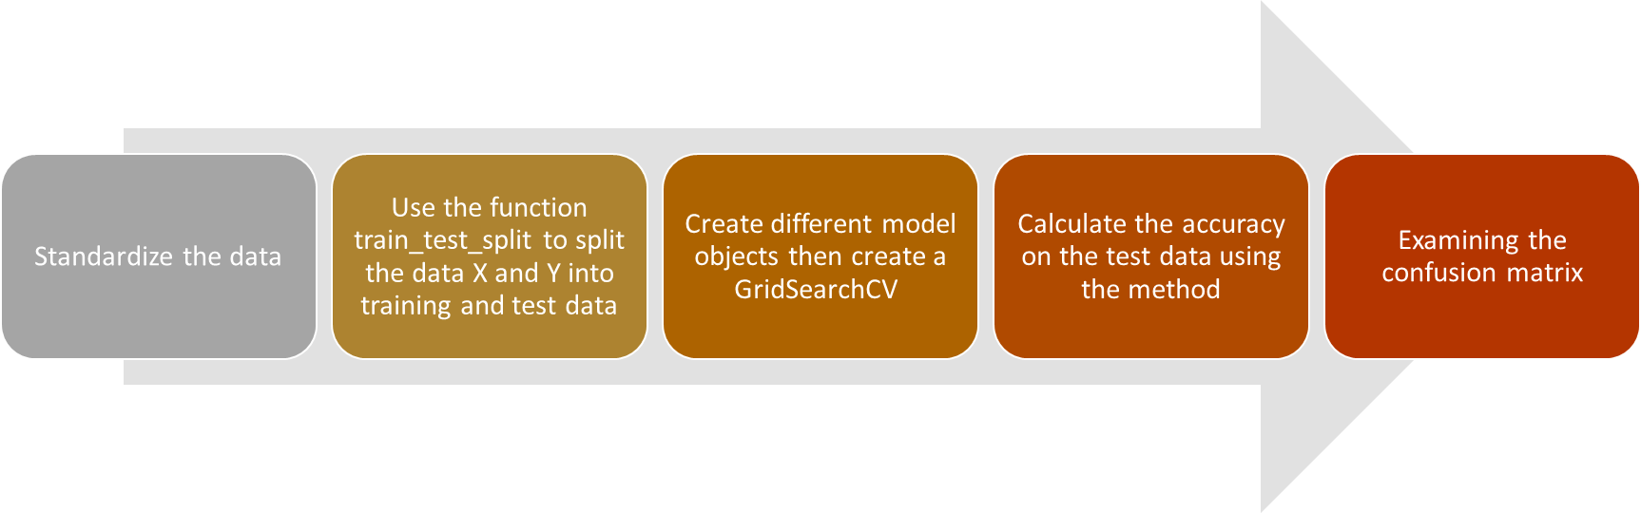
Predictive Analysis (Classification)
https://github.com/sinasorme/IBM-Data-Science-Capstone/blob/Module4/module_4_SpaceX_Machine_Learning_Prediction_Part_5.jupyterlite%20(1).ipynb

Slide 16
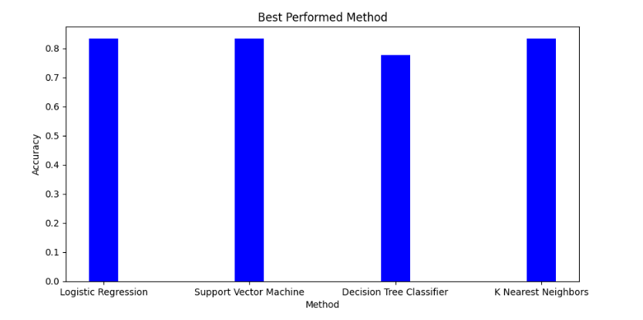
Results
The SVM, KNN, and Logistic Regression models are the best in terms of prediction accuracy for this dataset.
Low weighted payloads perform better than the heavier payloads.
The success rates for SpaceX launches is directly proportional time in years they will eventually perfect the launches.
KSC LC 39A had the most successful launches from all the sites.
Orbit GEO,HEO,SSO,ES L1 has the best Success Rate.
https://github.com/sinasorme/IBM-Data-Science-Capstone/blob/Module4/module_4_SpaceX_Machine_Learning_Prediction_Part_5.jupyterlite%20(1).ipynb

Slide 17
Section 2
Insights Drawn from EDA

Slide 18
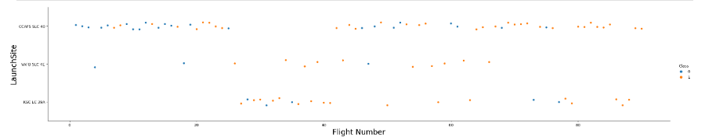
Flight Number vs. Launch Site
Launches from the site of CCAFS SLC 40 are significantly higher than lunches from other sites
https://github.com/sinasorme/IBM-Data-Science-Capstone/blob/Module4/IBM-DS0321EN-SkillsNetwork_labs_module_2_jupyter-labs-eda-dataviz.ipynb.jupyterlite.ipynb

Slide 19
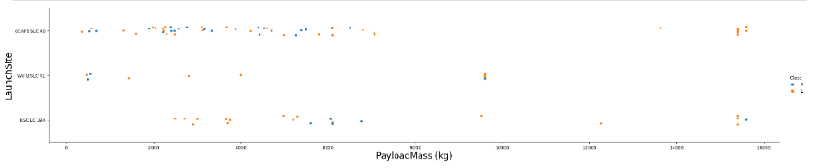
Payload vs. Launch Site
The majority of Pay Loads with lower Mass have been launched from CCAFS SLC 40
https://github.com/sinasorme/IBM-Data-Science-Capstone/blob/Module4/IBM-DS0321EN-SkillsNetwork_labs_module_2_jupyter-labs-eda-dataviz.ipynb.jupyterlite.ipynb​

Slide 20
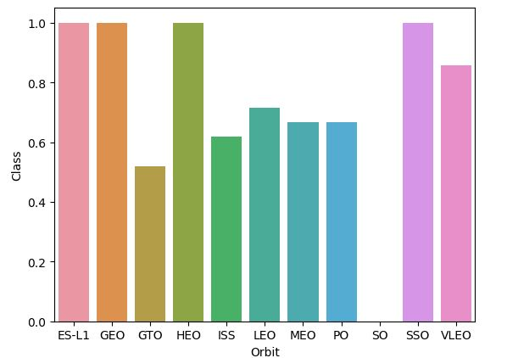
Success Rate vs. Orbit Type
ESL1, GEO, HEO and SSO orbits had the highest success rate.
https://github.com/sinasorme/IBM-Data-Science-Capstone/blob/Module4/IBM-DS0321EN-SkillsNetwork_labs_module_2_jupyter-labs-eda-dataviz.ipynb.jupyterlite.ipynb​

Slide 21
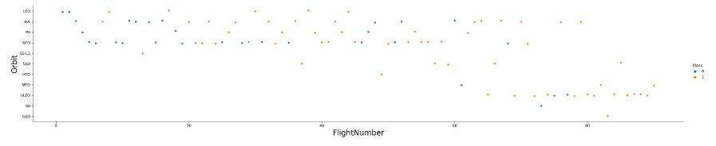
Flight Number vs. Orbit Type
There is an increasing rate of VLEO launches in recent years.
https://github.com/sinasorme/IBM-Data-Science-Capstone/blob/Module4/IBM-DS0321EN-SkillsNetwork_labs_module_2_jupyter-labs-eda-dataviz.ipynb.jupyterlite.ipynb​

Slide 22
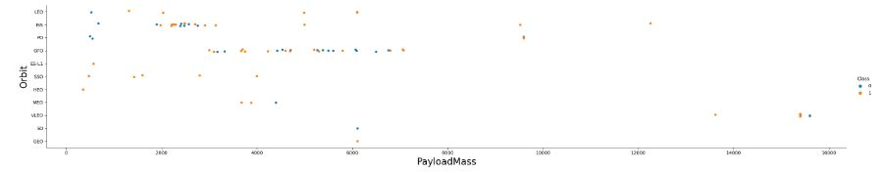
Payload vs. Orbit Type
At ISS most of payloads were around 2000
At GTO most of payload were between 3000 and 7000
https://github.com/sinasorme/IBM-Data-Science-Capstone/blob/Module4/IBM-DS0321EN-SkillsNetwork_labs_module_2_jupyter-labs-eda-dataviz.ipynb.jupyterlite.ipynb​

Slide 23
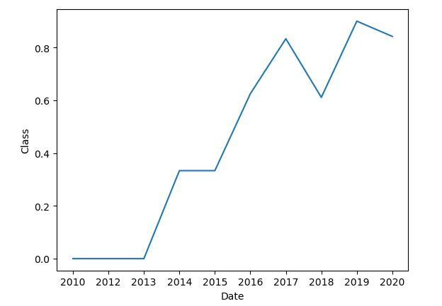
Launch Success Yearly Trend
•Success rate has increased incredibly in recent years
https://github.com/sinasorme/IBM-Data-Science-Capstone/blob/Module4/IBM-DS0321EN-SkillsNetwork_labs_module_2_jupyter-labs-eda-dataviz.ipynb.jupyterlite.ipynb​

Slide 24
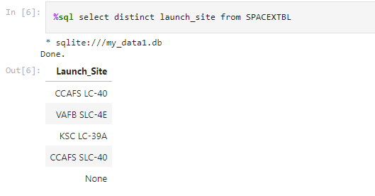
All Launch Site Names
https://github.com/sinasorme/IBM-Data-Science-Capstone/blob/Module4/jupyter-labs-eda-sql-coursera_sqllite.ipynb

Slide 25
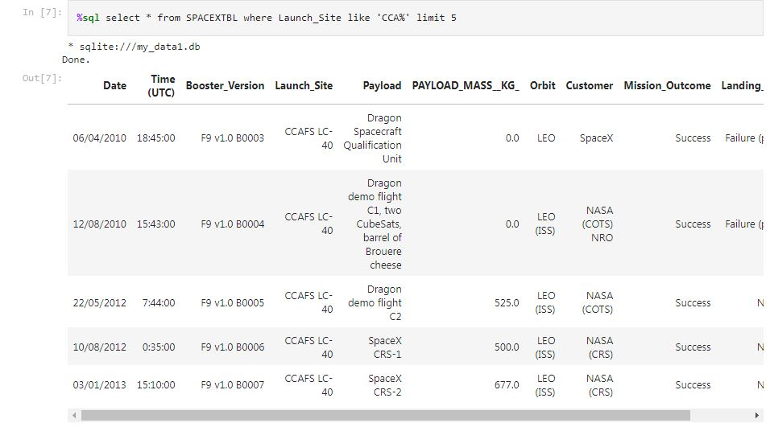
Launch Site Names Begin with 'CCA'
https://github.com/sinasorme/IBM-Data-Science-Capstone/blob/Module4/jupyter-labs-eda-sql-coursera_sqllite.ipynb

Slide 26
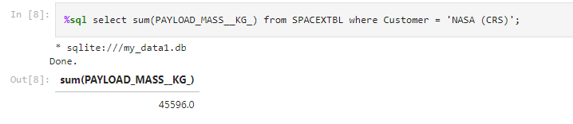
Total Payload Mass
https://github.com/sinasorme/IBM-Data-Science-Capstone/blob/Module4/jupyter-labs-eda-sql-coursera_sqllite.ipynb

Slide 27
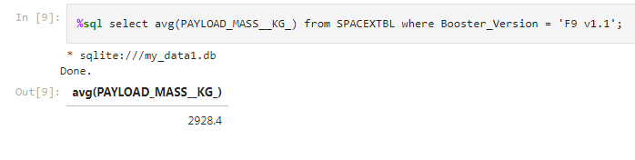
Average Payload Mass by F9 v1.1
https://github.com/sinasorme/IBM-Data-Science-Capstone/blob/Module4/jupyter-labs-eda-sql-coursera_sqllite.ipynb

Slide 28
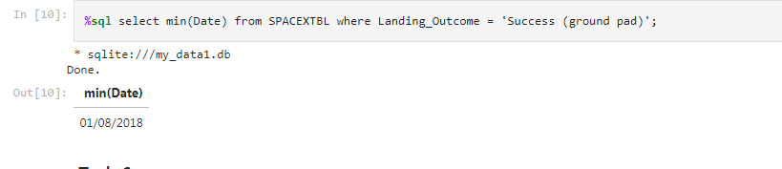
First Successful Ground Landing Date
https://github.com/sinasorme/IBM-Data-Science-Capstone/blob/Module4/jupyter-labs-eda-sql-coursera_sqllite.ipynb

Slide 29
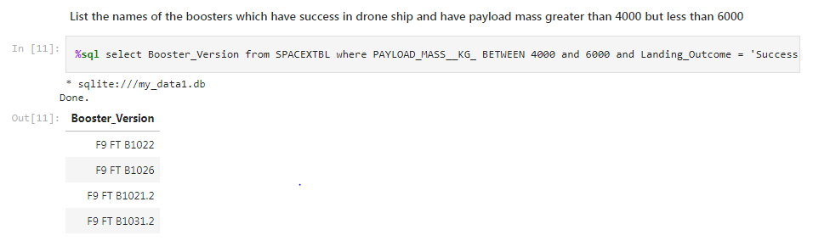
Successful Drone Ship Landing with Payload between 4000 and 6000
%sql select booster_version from SPACEXTBL where "Landing_Outcome"='Success (drone ship)' and PAYLOAD_MASS__KG_ between 4000 and 6000
https://github.com/sinasorme/IBM-Data-Science-Capstone/blob/Module4/jupyter-labs-eda-sql-coursera_sqllite.ipynb

Slide 30
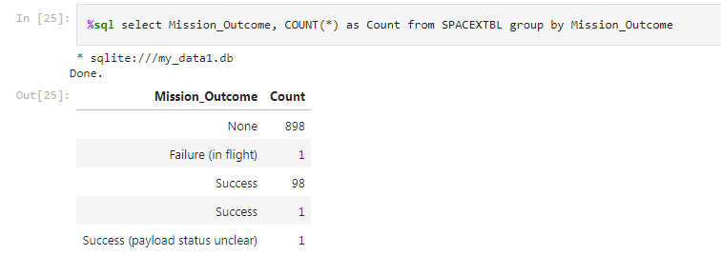
Total Number of Successful and Failure Mission Outcomes
https://github.com/sinasorme/IBM-Data-Science-Capstone/blob/Module4/jupyter-labs-eda-sql-coursera_sqllite.ipynb

Slide 31
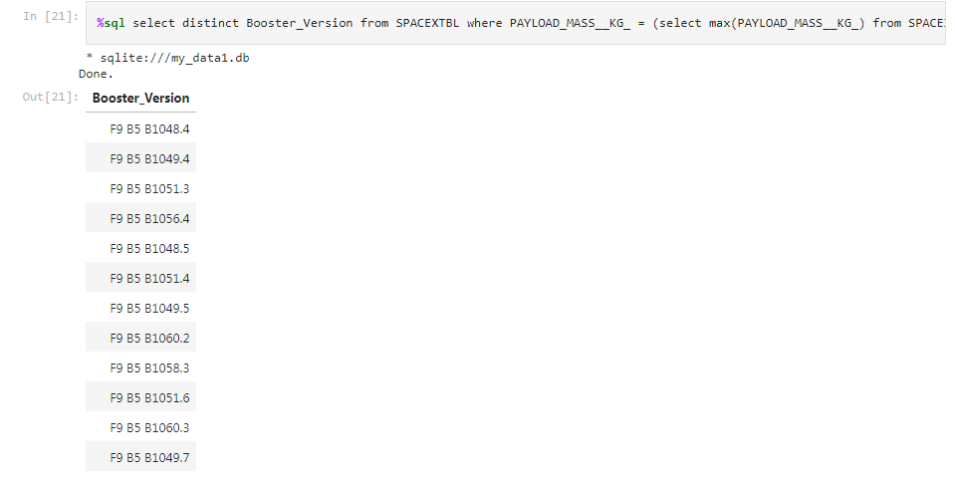
Boosters Carried Maximum Payload
https://github.com/sinasorme/IBM-Data-Science-Capstone/blob/Module4/jupyter-labs-eda-sql-coursera_sqllite.ipynb

Slide 32
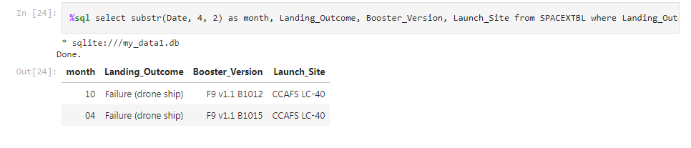
2015 Launch Records
%sql select substr(Date, 4, 2) as month, "Landing_Outcome", Booster_Version , Launch_Site from SPACEXTBL where "Landing_Outcome" = 'Failure (drone ship)' and substr(Date,7,4)='2015'
https://github.com/sinasorme/IBM-Data-Science-Capstone/blob/Module4/jupyter-labs-eda-sql-coursera_sqllite.ipynb

Slide 33
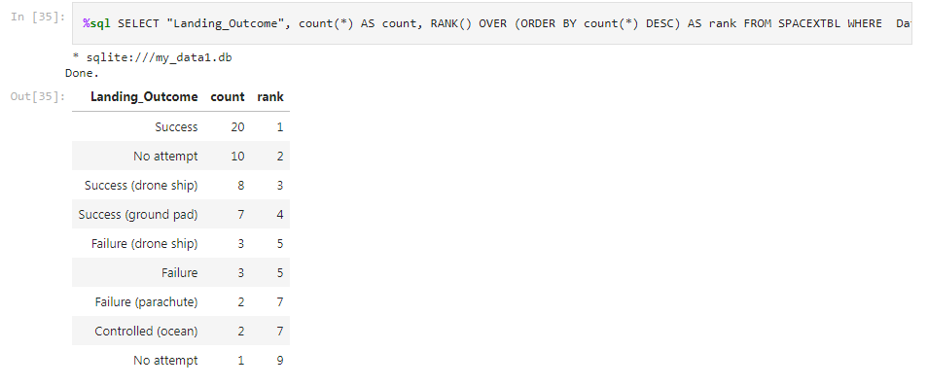
Rank Landing Outcomes Between 2010-06-04 and 2017-03-20
•%sql SELECT "Landing_Outcome", count(*) AS count, RANK() OVER (ORDER BY count(*) DESC) AS rank FROM SPACEXTBL WHERE "Landing_Outcome" like 'Success%' and Date between '04-06-2010' and '20-03-2017' GROUP BY "Landing_Outcome" ORDER BY count DESC
https://github.com/sinasorme/IBM-Data-Science-Capstone/blob/Module4/jupyter-labs-eda-sql-coursera_sqllite.ipynb

Slide 34
Section 3
Launch Sites
Proximities Analysis

Slide 35
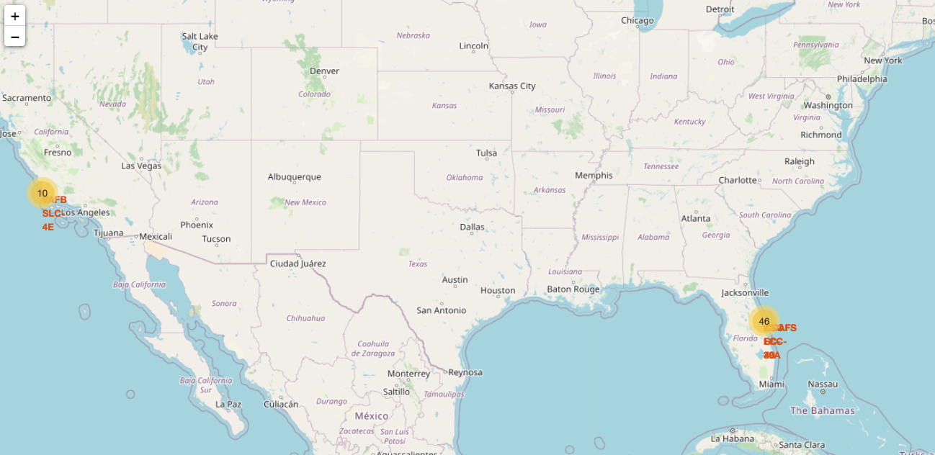
Folium Map Screenshot 1

Slide 36

Folium Map Screenshot 2

Slide 37

Folium Map Screenshot 3

Slide 38
Section 4
Build a Dashboard with Plotly Dash

Slide 39

DASHBOARD
https://github.com/sinasorme/IBM-Data-Science-Capstone/blob/Module3/spacex_dash_app.py

Slide 40
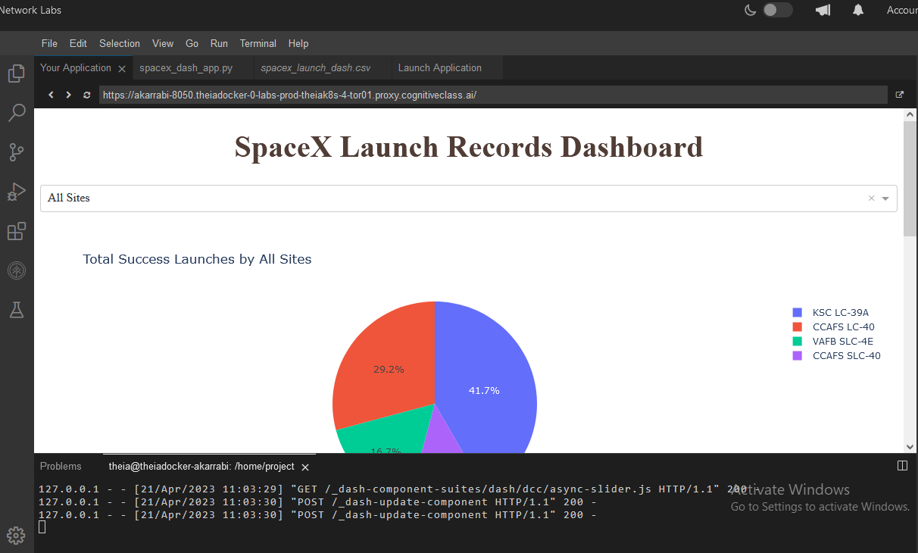
DASHBOARD TAB 1
Screenshot of dashboard tab 1 goes here

Slide 41
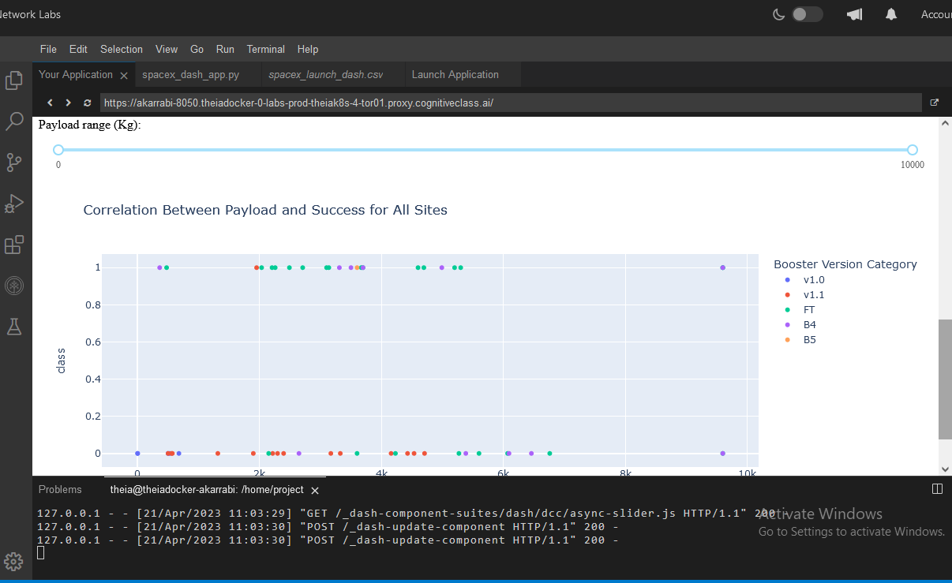
DASHBOARD TAB 2
Screenshot of dashboard tab 2 goes here

Slide 42
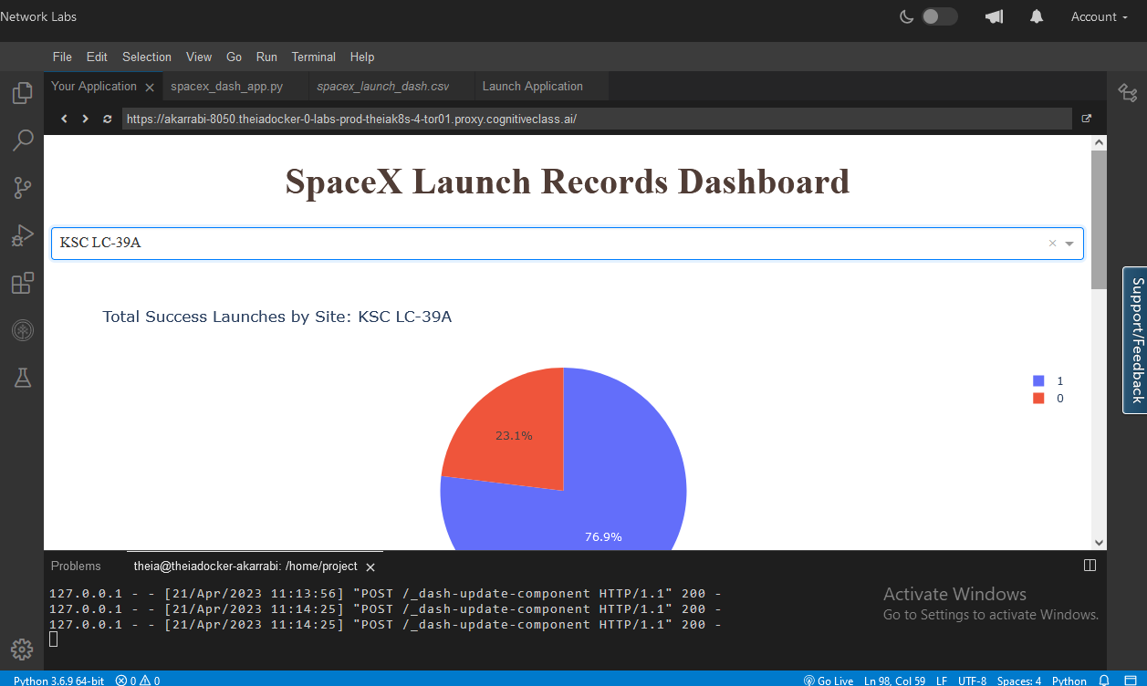
DASHBOARD TAB 3
Screenshot of dashboard tab 3 goes here

Slide 43
Section 5
Predictive Analysis (Classification)

Slide 44
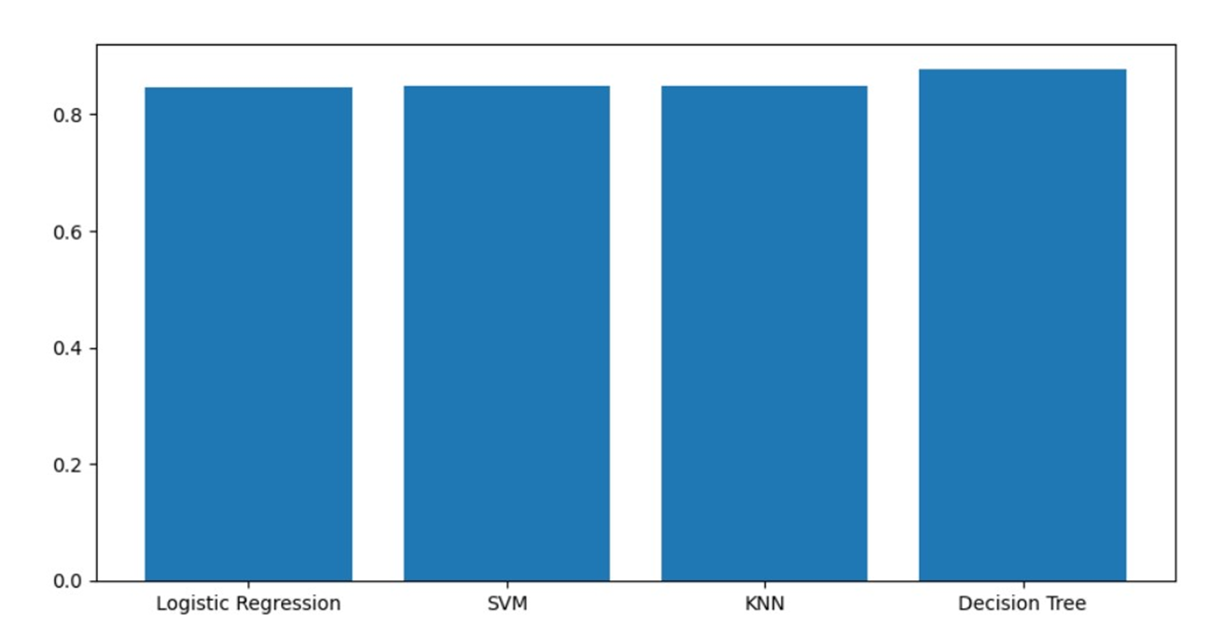
Classification Accuracy

Slide 45
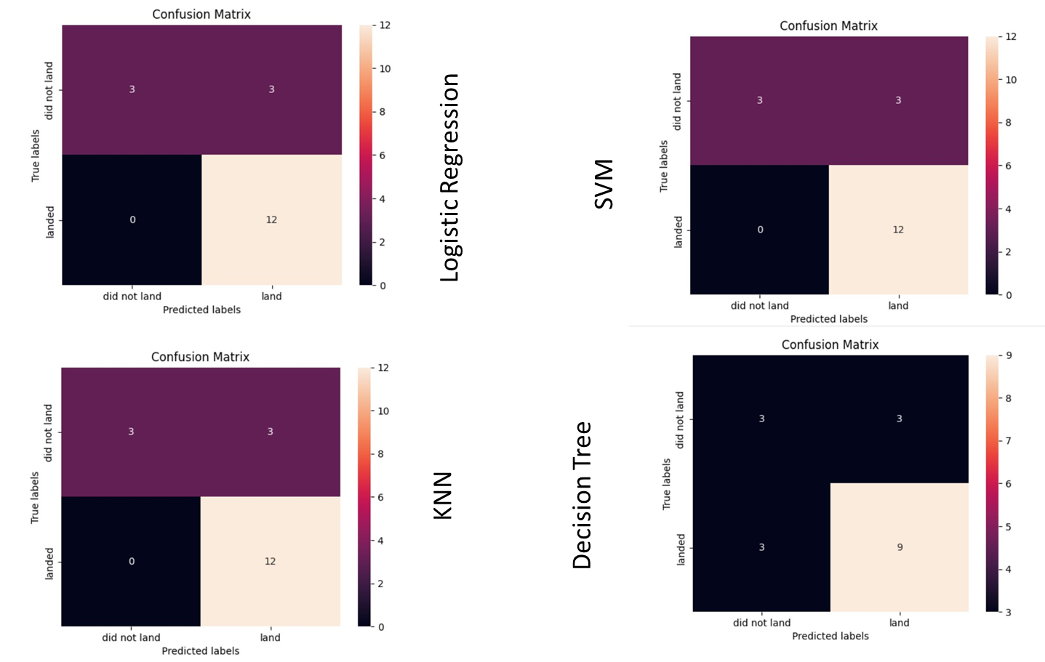
Confusion Matrix

Slide 46
Conclusions
The Decision Tree model has the best prediction accuracy.
Low weighted payloads has a better success rate than the heavier payloads.
The success rates for SpaceX launches have increased significantly in recent years.
KSC LC 39A had the most successful launches among all other sites.
Orbit GEO,HEO,SSO,ES L1 had the best Success Rate.

Slide 47
APPENDIX
Include any relevant assets like Python code snippets, SQL queries, charts, Notebook outputs, or data sets that you may have created during this project

